Slide 1


Jilton Hotels
Mario Alcaraz, Adrián Berenguer, Madani El Mrabet,
Rosa María Rodríguez, Javier Rodríguez, Ilya Slyusarchuk

Slide 2
01
Introduction
03
Page Interfaces
Main page and what differentiate us from the others
Implementations of the interfaces for each page and possible improvements
02
Public vs Private
04
Conclusion
Benefits you have from being registered
Briefly sum up of all the contents
TABLE OF CONTENTS

Slide 3
01
Introduction

Slide 4
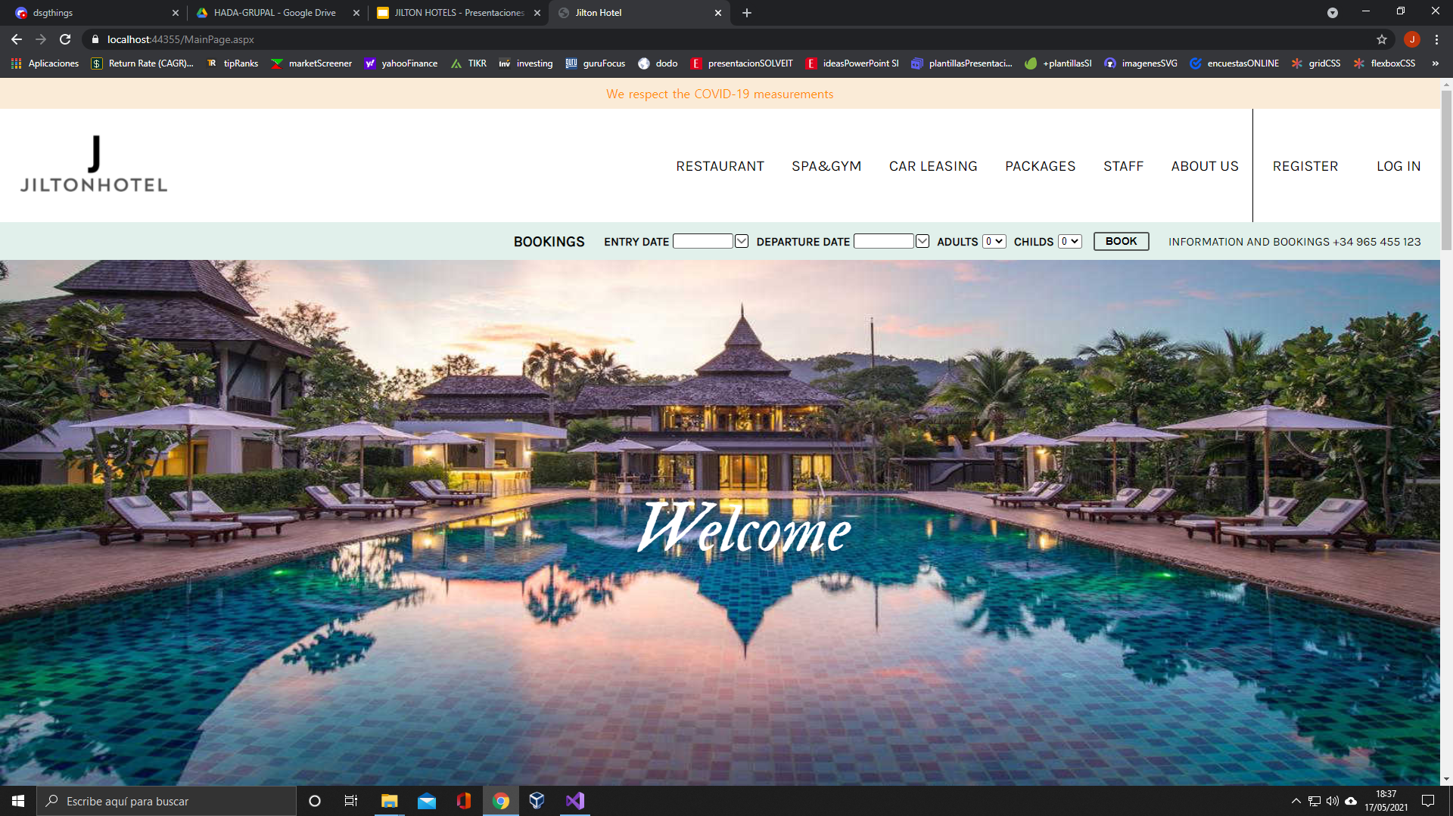
What makes us different from the others?
Intuitive and modern interface
Attractive style
Possibility to choose staff in the booked services

Slide 6
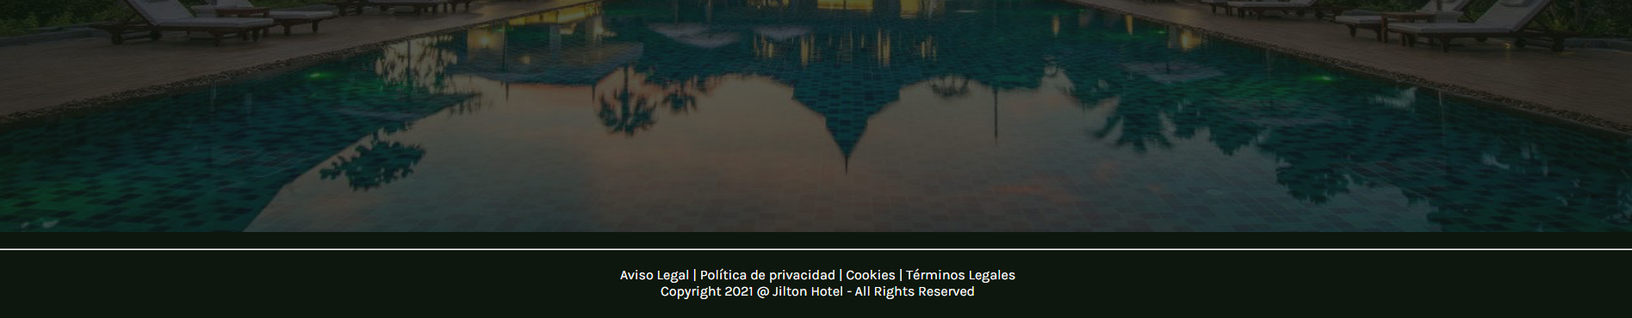

Slide 8
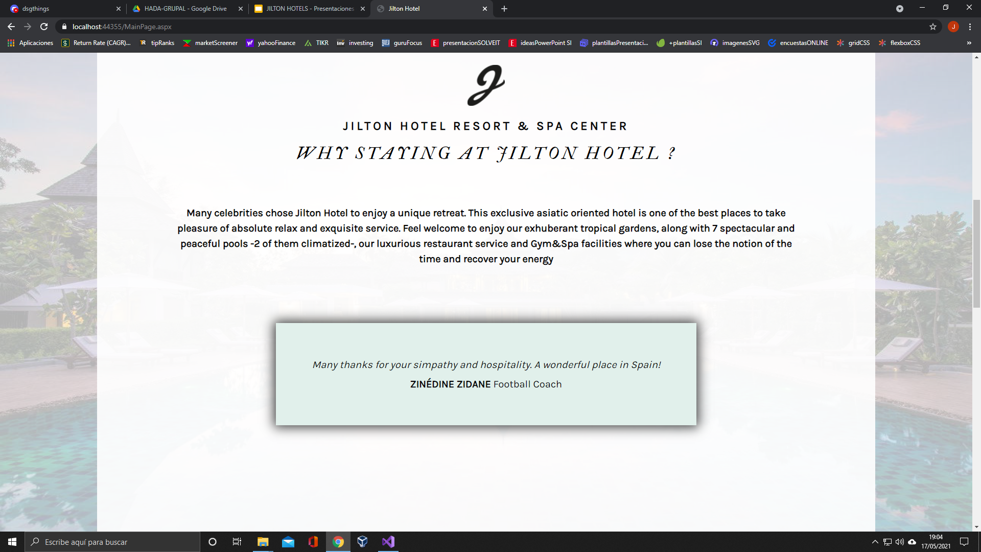

Slide 9
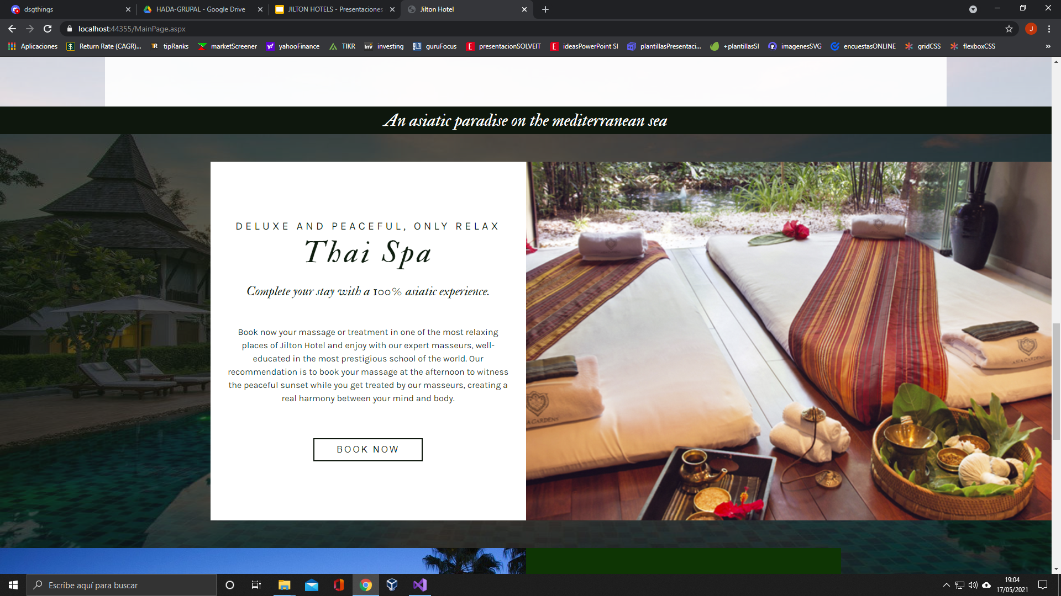
CSS-TRICKS.COM

Slide 10
02
Public vs Private

Slide 11


Slide 12

PUBLIC SECTION
Consult information about rooms and extra services.
PRIVATE SECTION (Registered users)
Booking rooms and extra services.
Package offers.
ADMINISTRATOR SECTION
Capability to add, delete and update the database.

Slide 13
3.1
Pages Interface

Slide 14
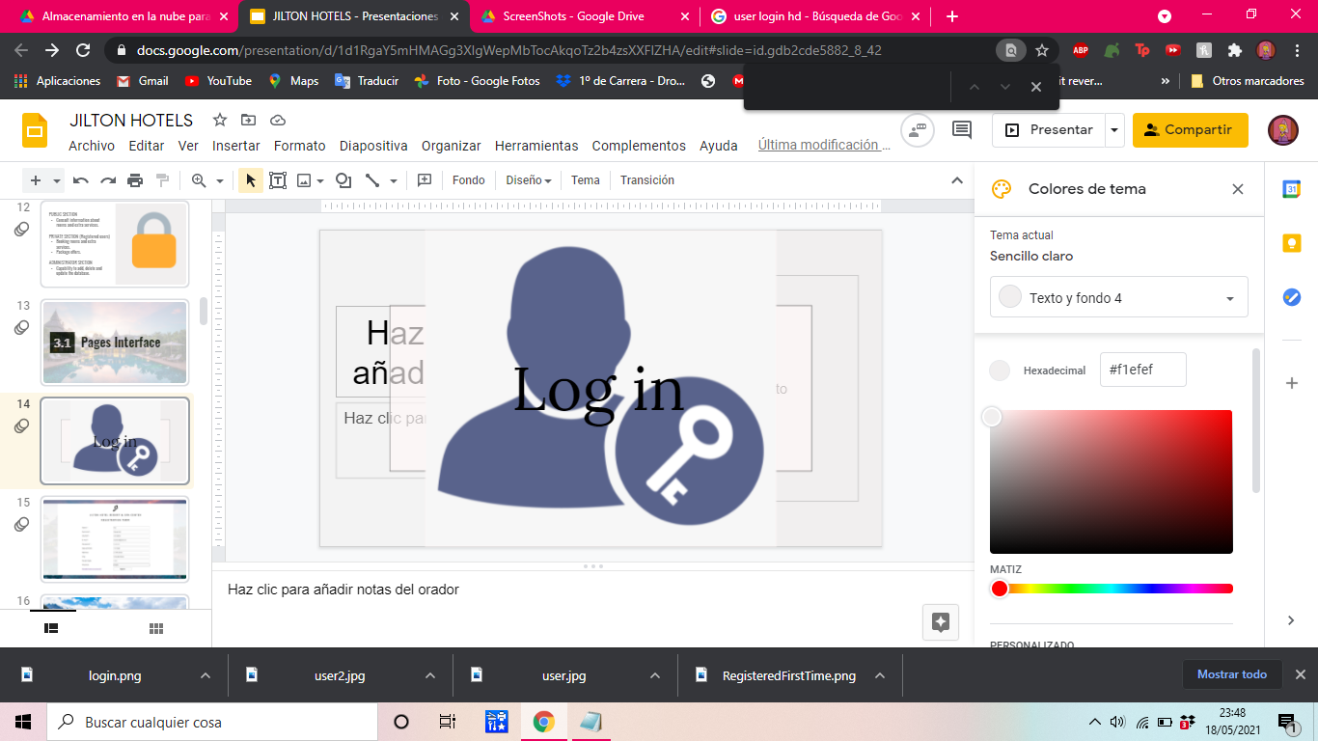

Log in

Slide 15
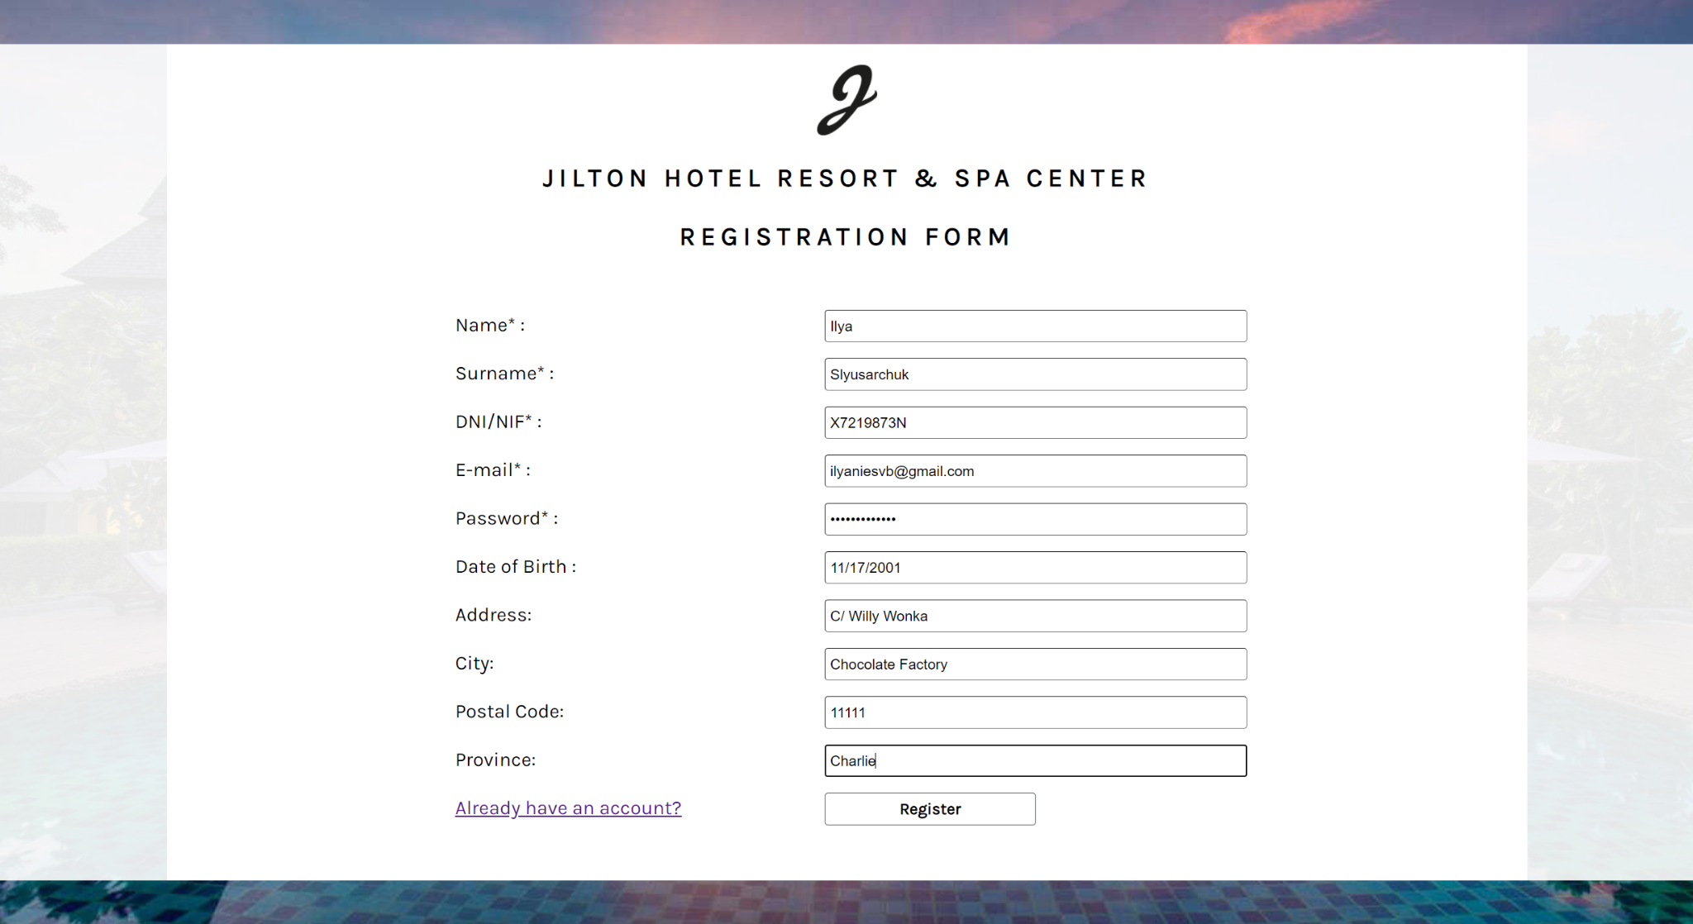

Slide 16
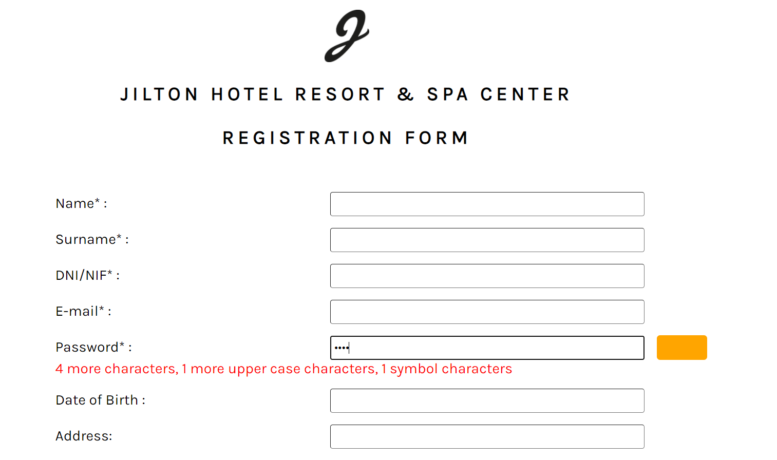
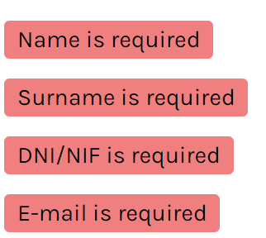
REQUIRED FIELD VALIDATOR
AJAX PASSWORD STRENGTH

Slide 17
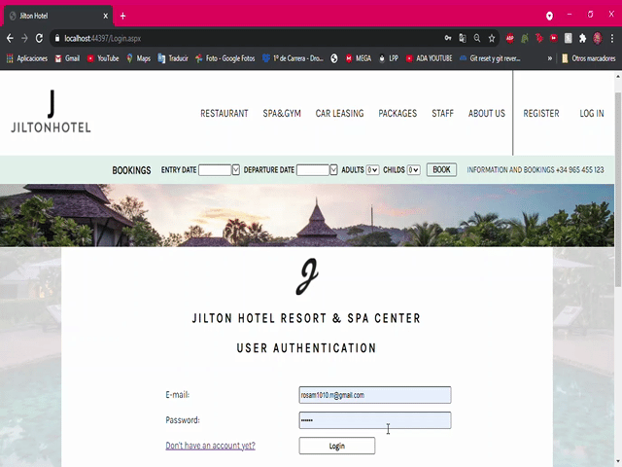

Slide 18

Services

Slide 19
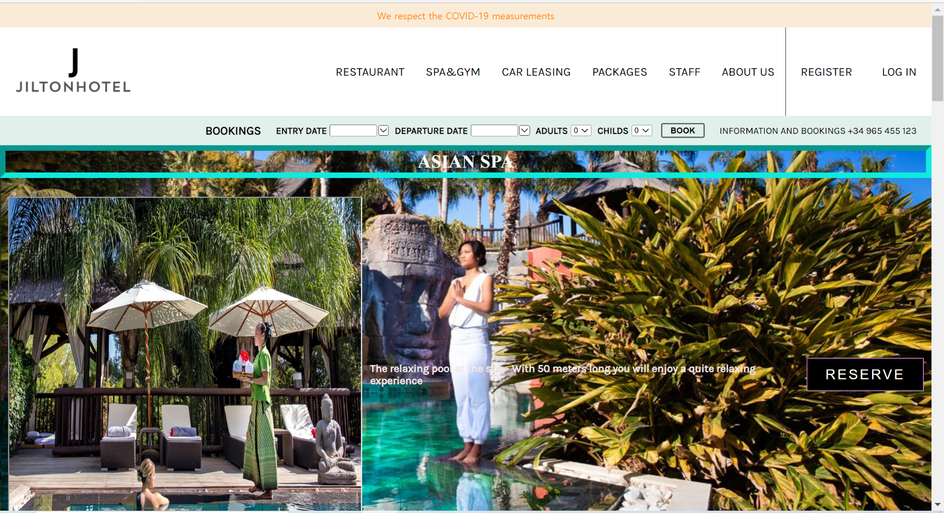

Slide 20

Packages

Slide 21
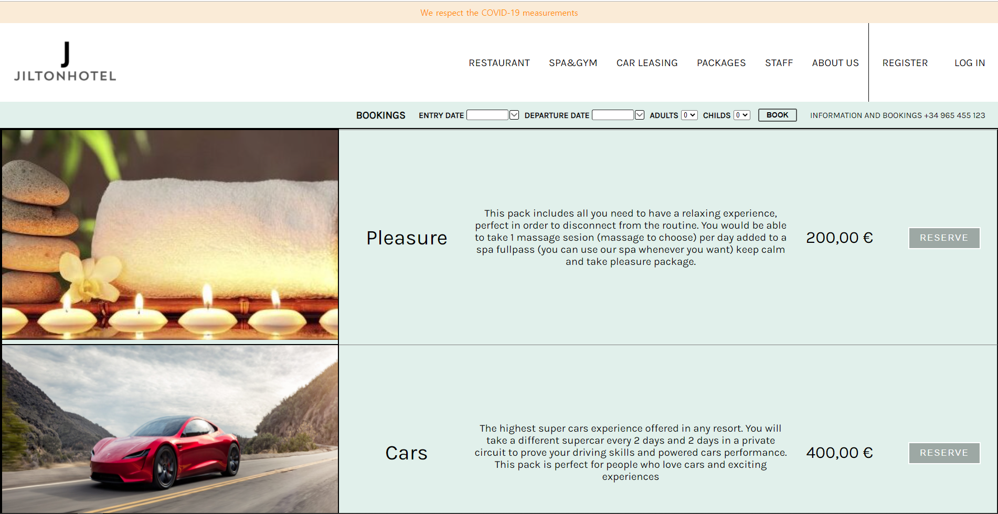

Slide 22

Car leasing

Slide 23
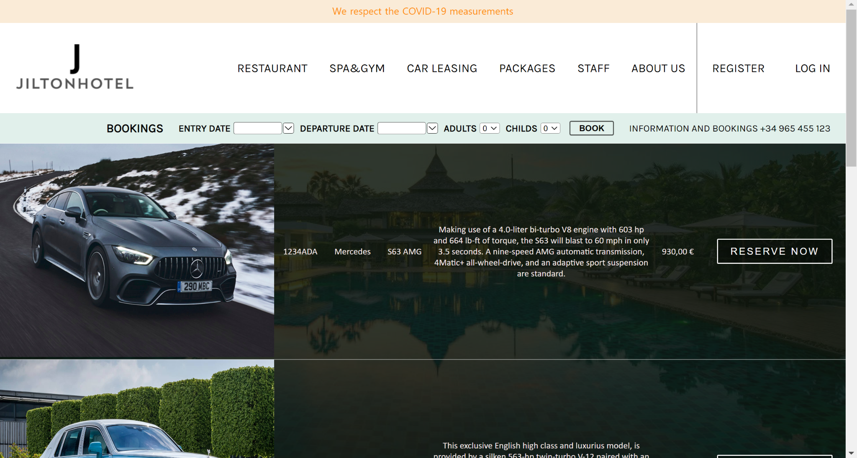

Slide 24
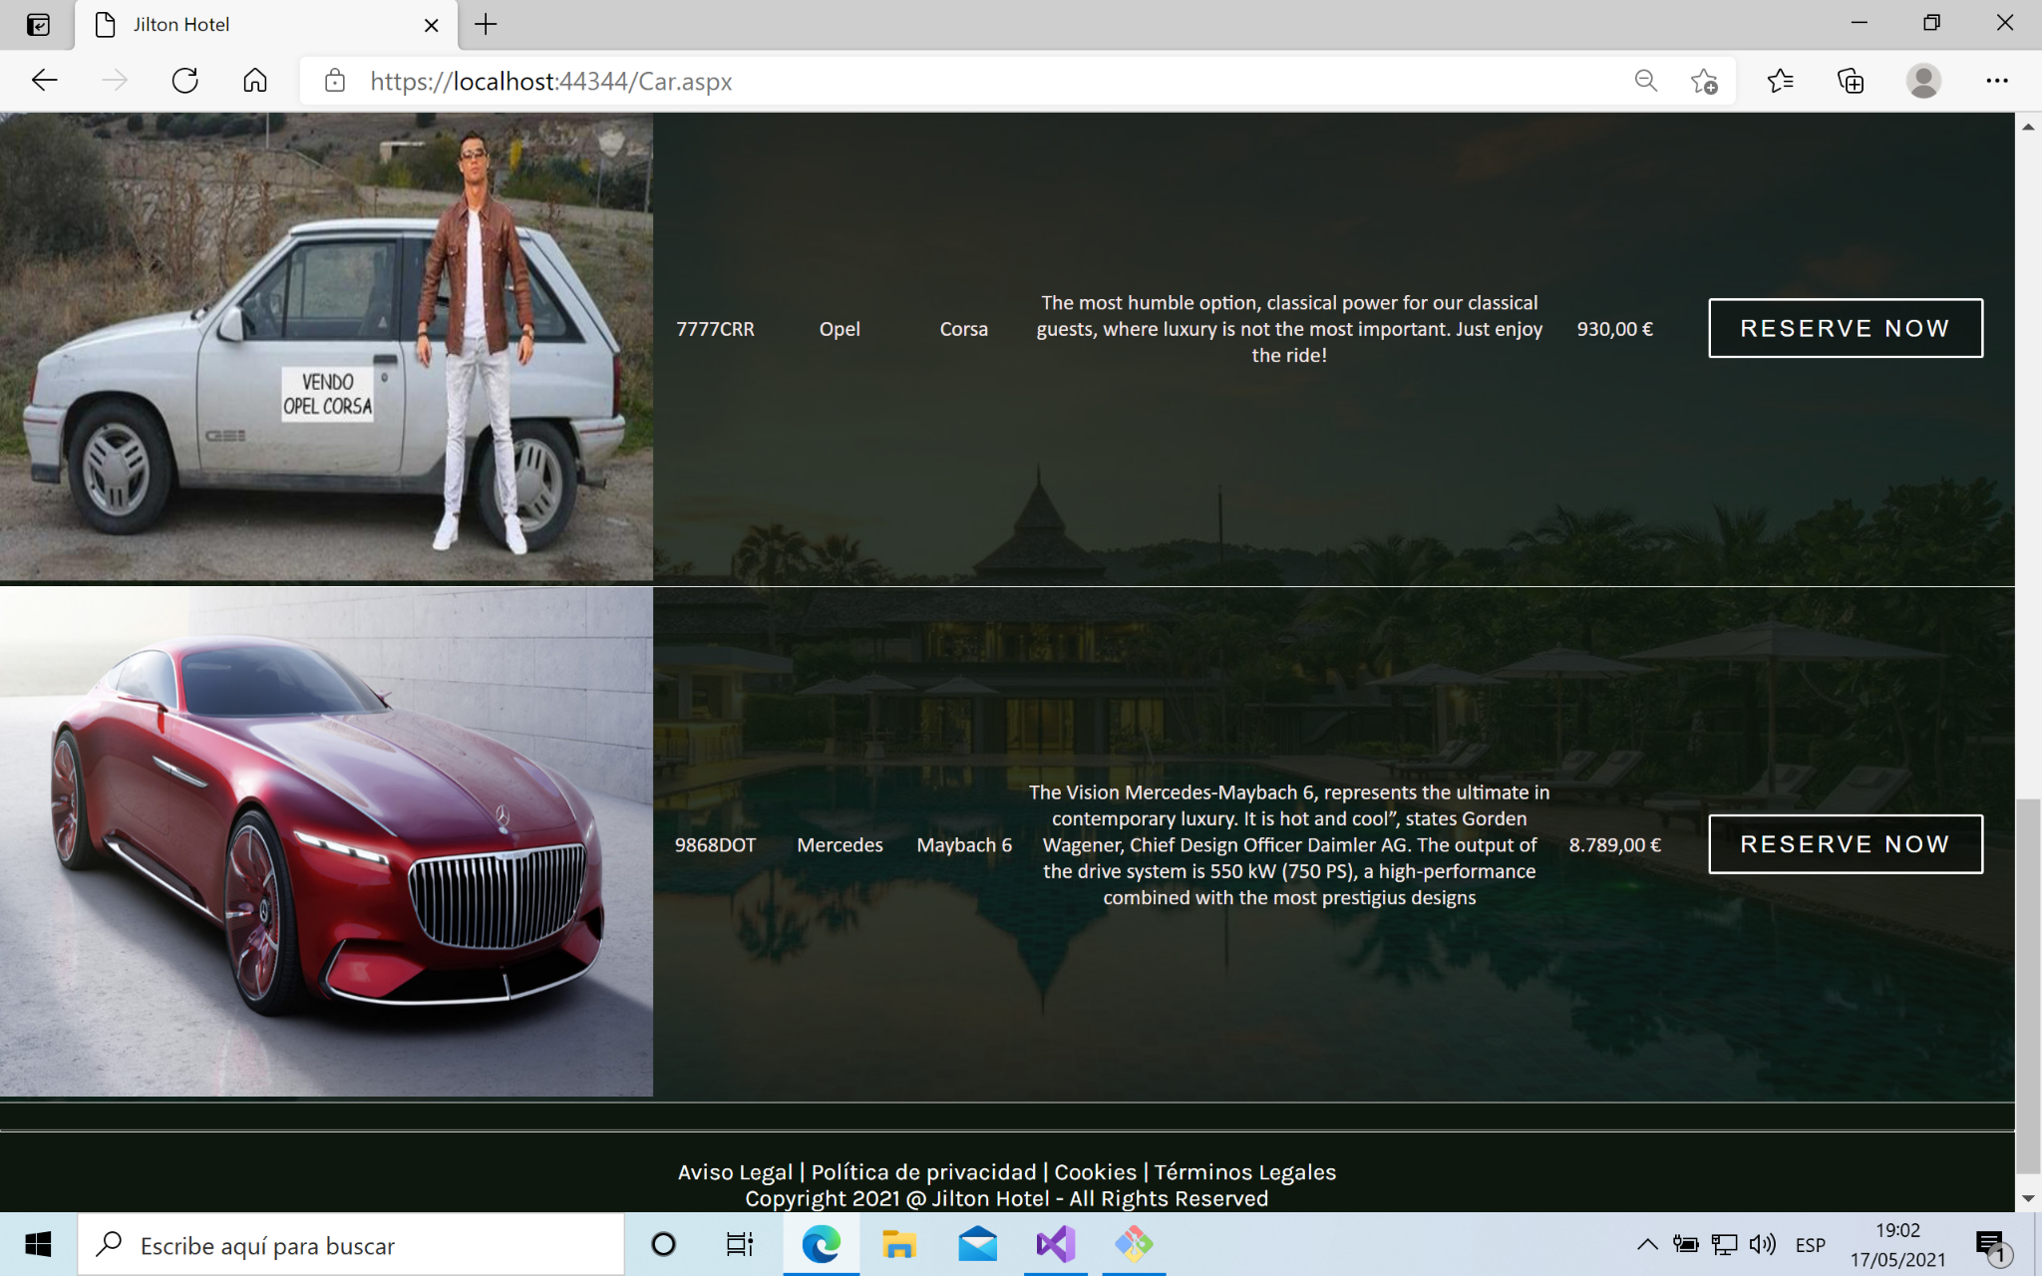

Slide 25
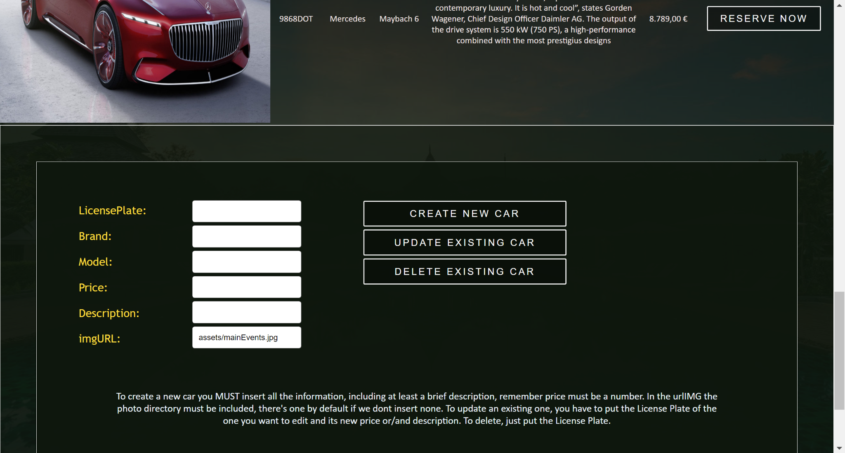
DISCONNECTED SQL OPERATIONS

Slide 26


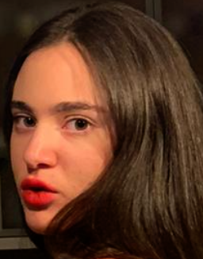






Slide 27
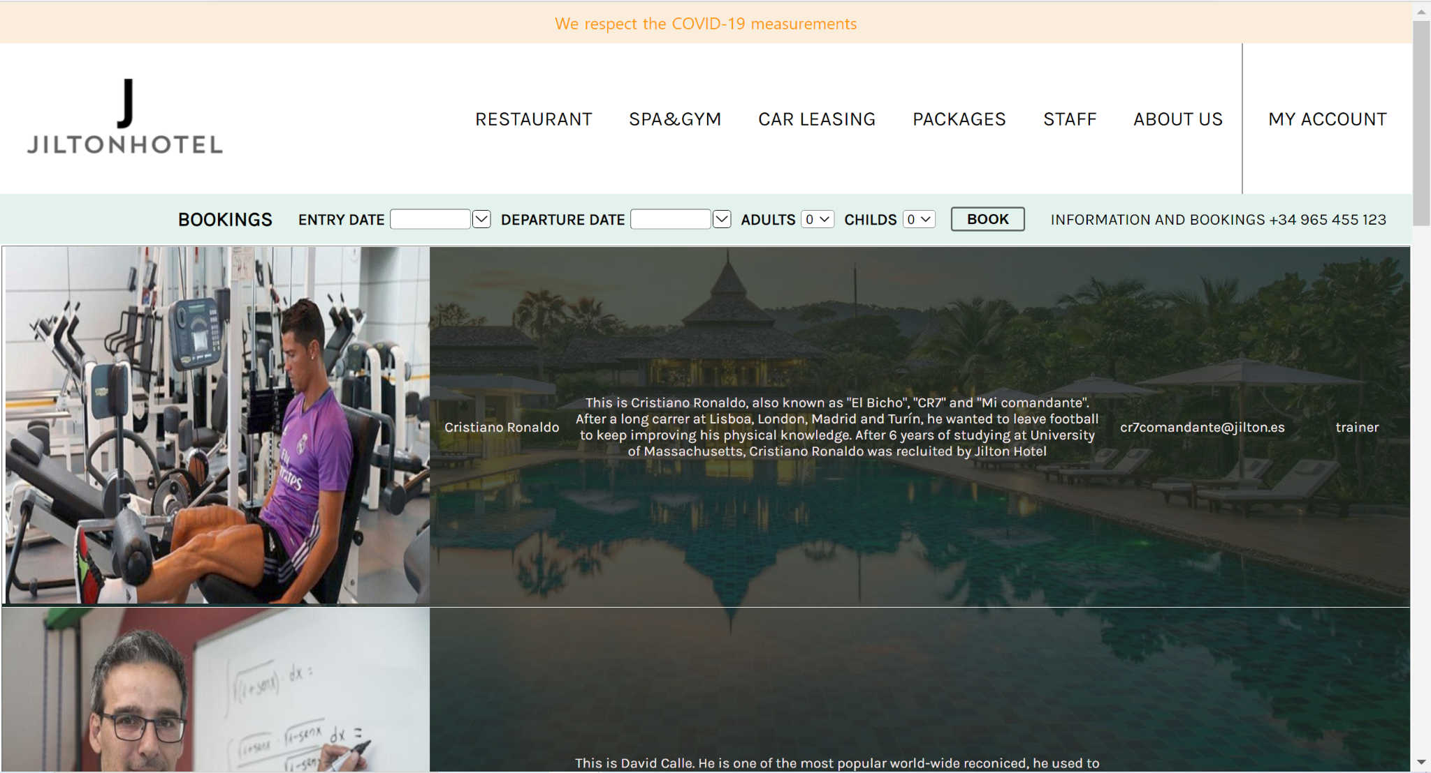

Slide 28
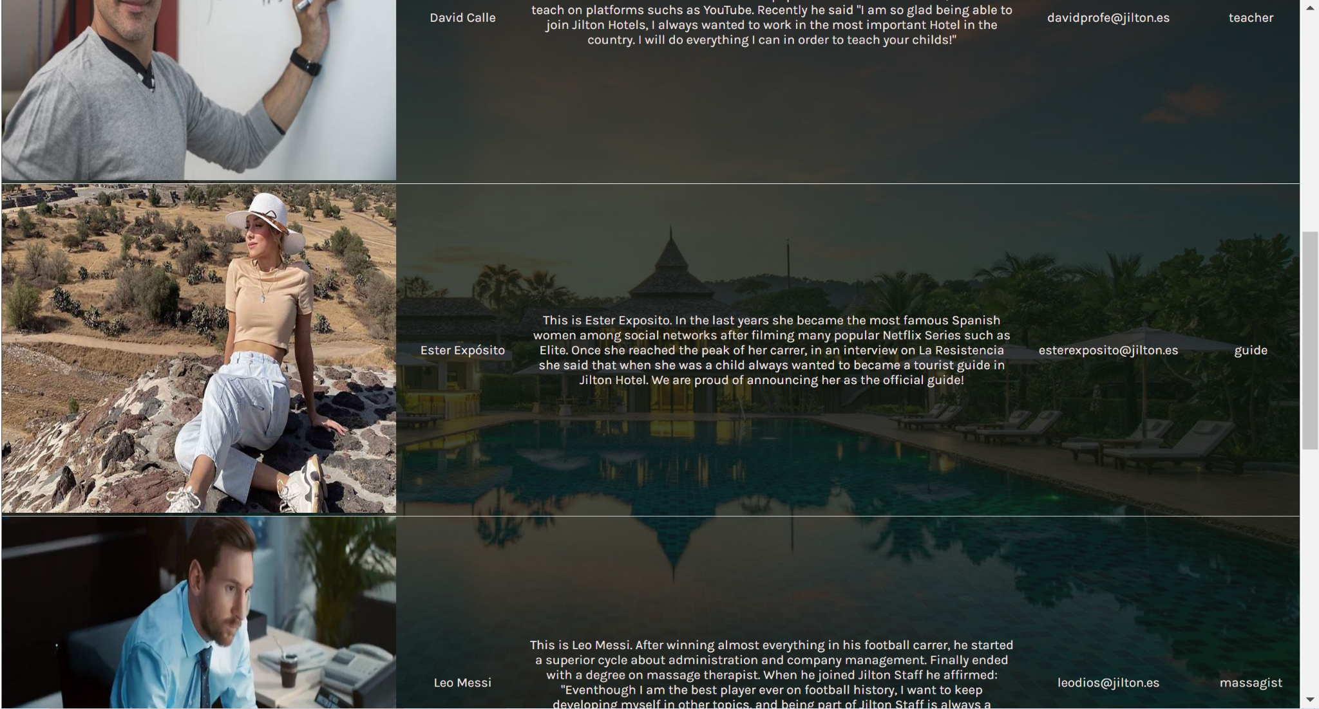

Slide 29
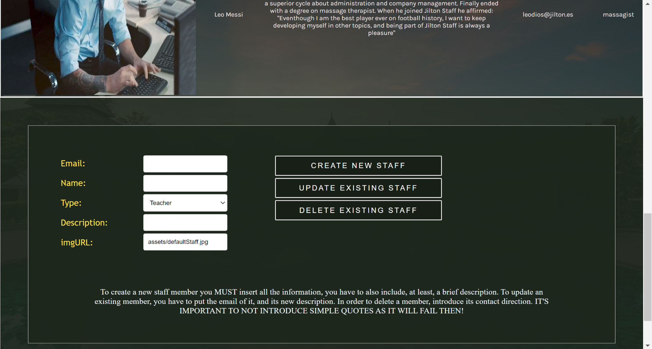
ADMIN FIELDS

Slide 30
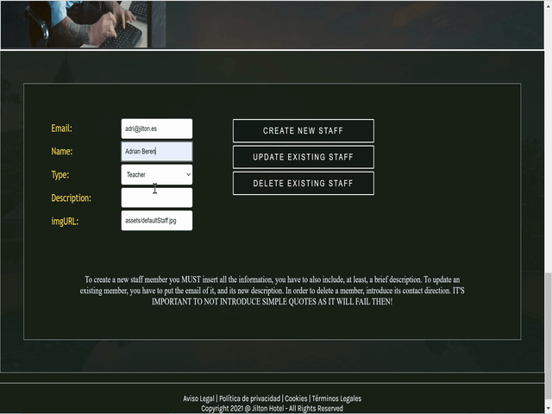

Slide 31

Restaurant

Slide 32
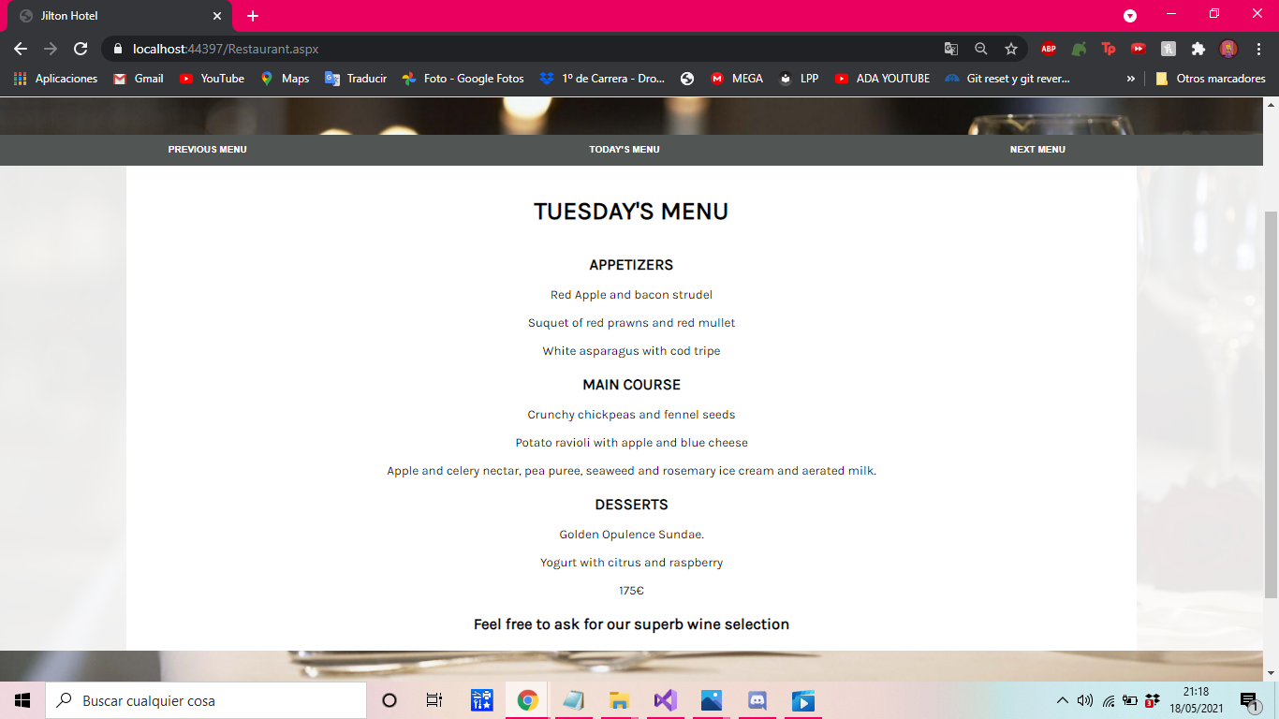

Slide 33
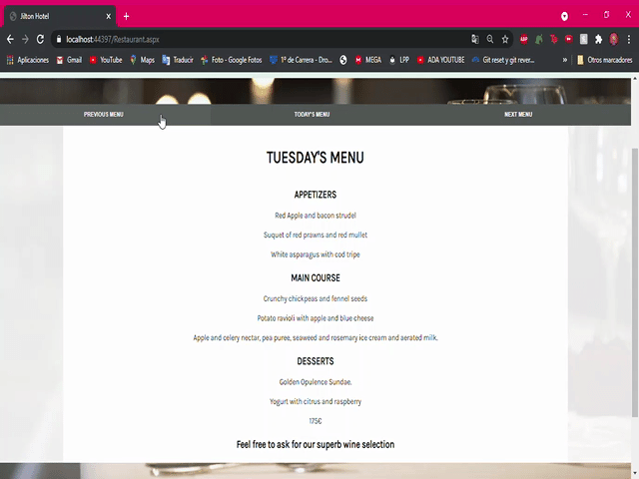

Slide 34

Rooms

Slide 35
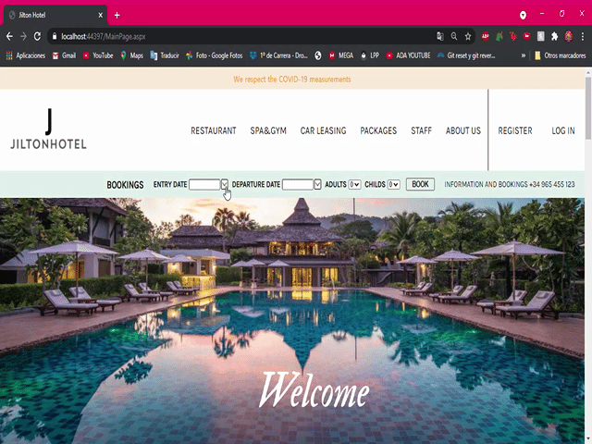

Slide 36
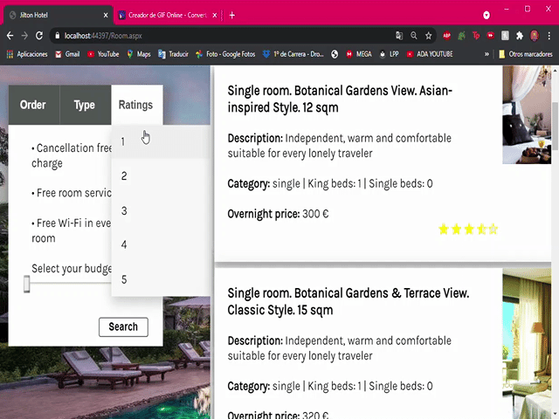

Slide 37
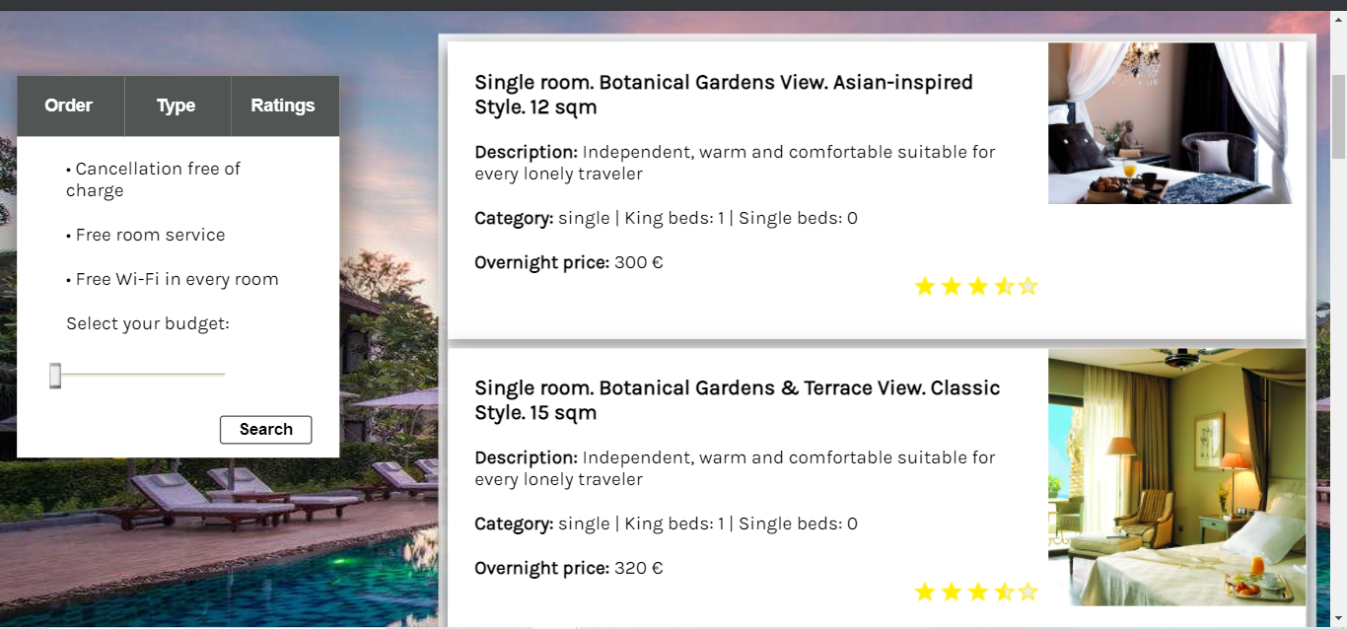
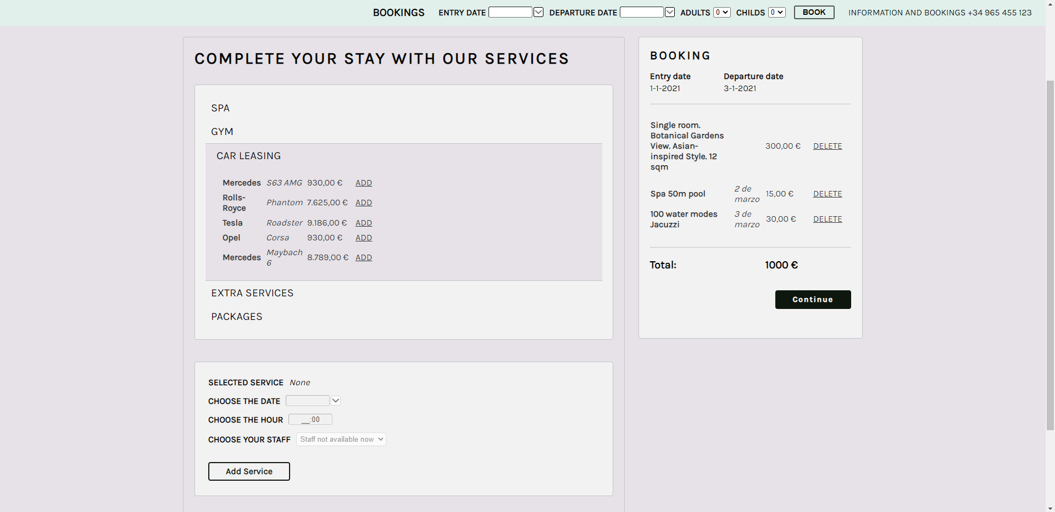
AJAX SLIDER EXTENDER
DROP DOWN LIST WITH ASP BUTTONS

Slide 38
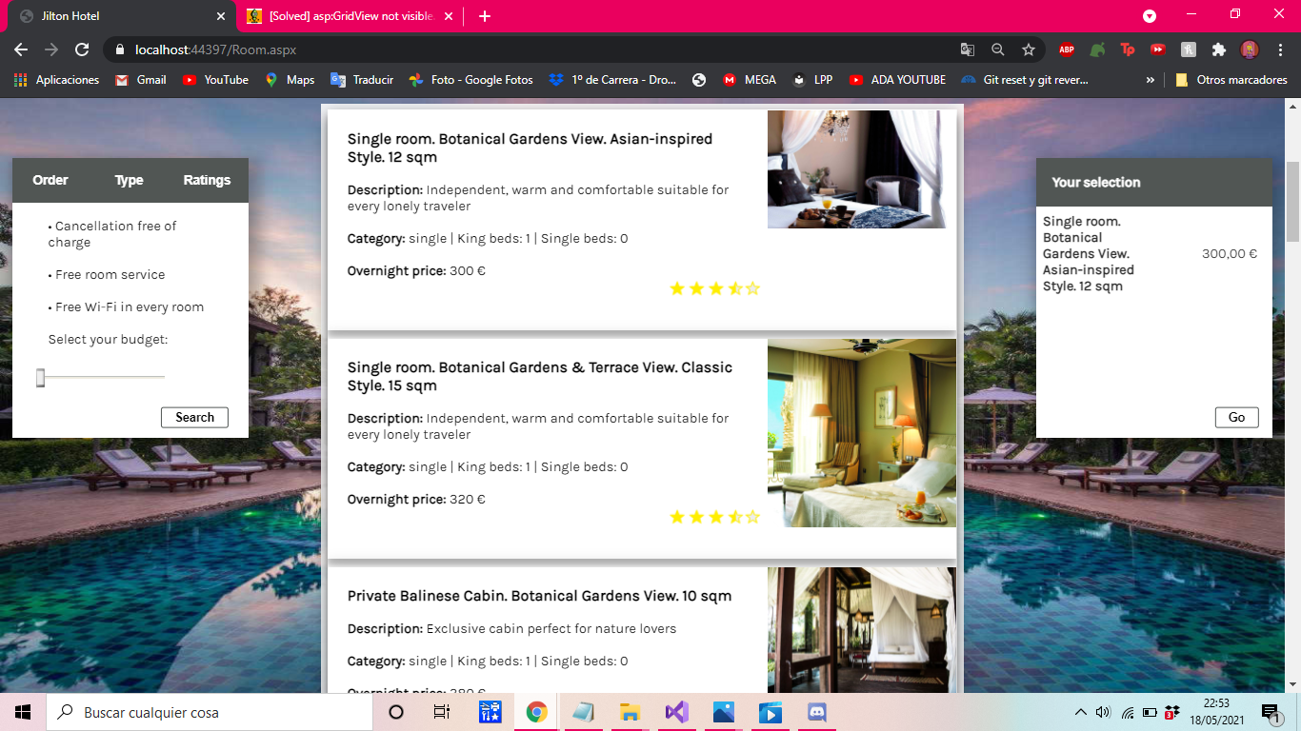
AJAX RATING
GRID VIEWS

Slide 39


Slide 40
AJAX ACCORDION
GRID VIEW
FLEX-BOX

Slide 41
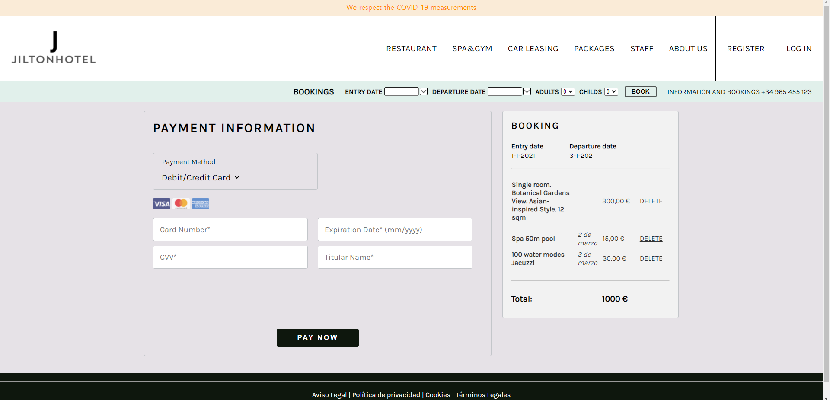

Slide 42
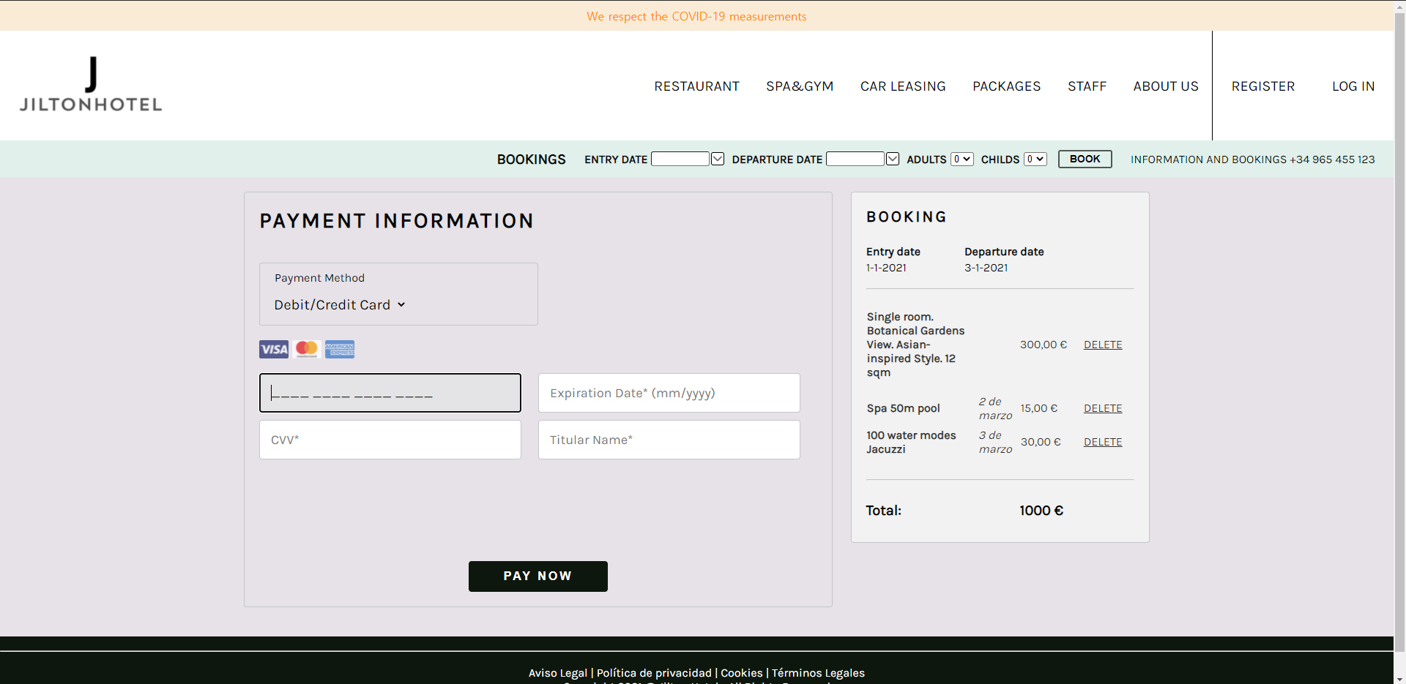
AJAX MASKED EDIT EXTENDER

Slide 43
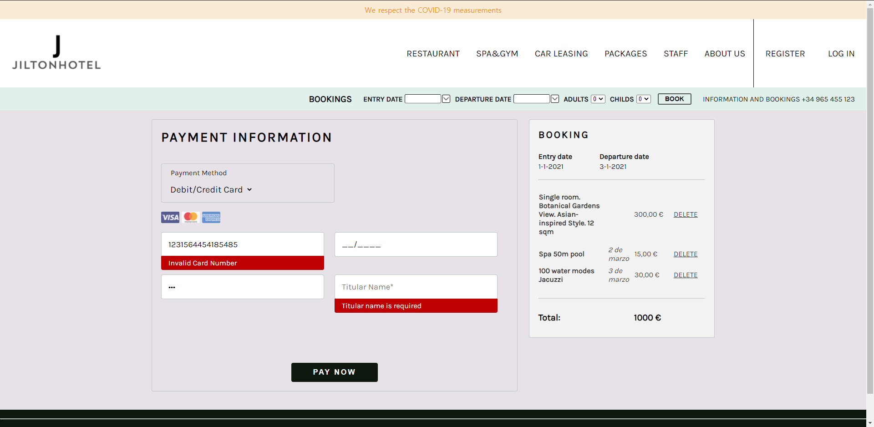
REQUIRED FIELD V. + REGULAR EXPRESSION V. + UPDATE PANEL

Slide 44
3.2
POSSIBLE IMPROVEMENTS

Slide 45
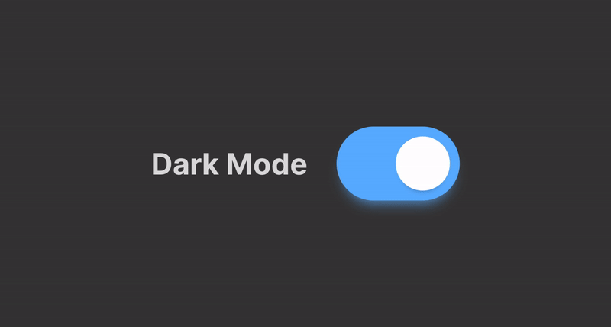

Slide 46
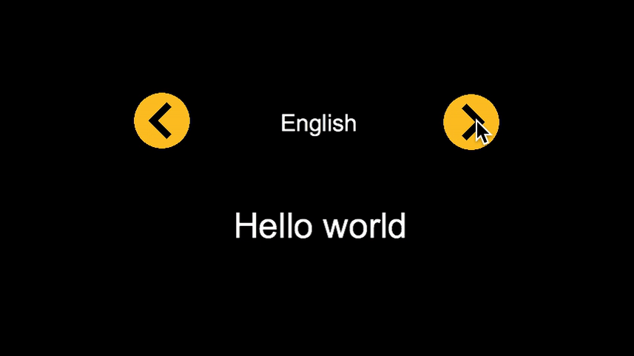

Slide 47

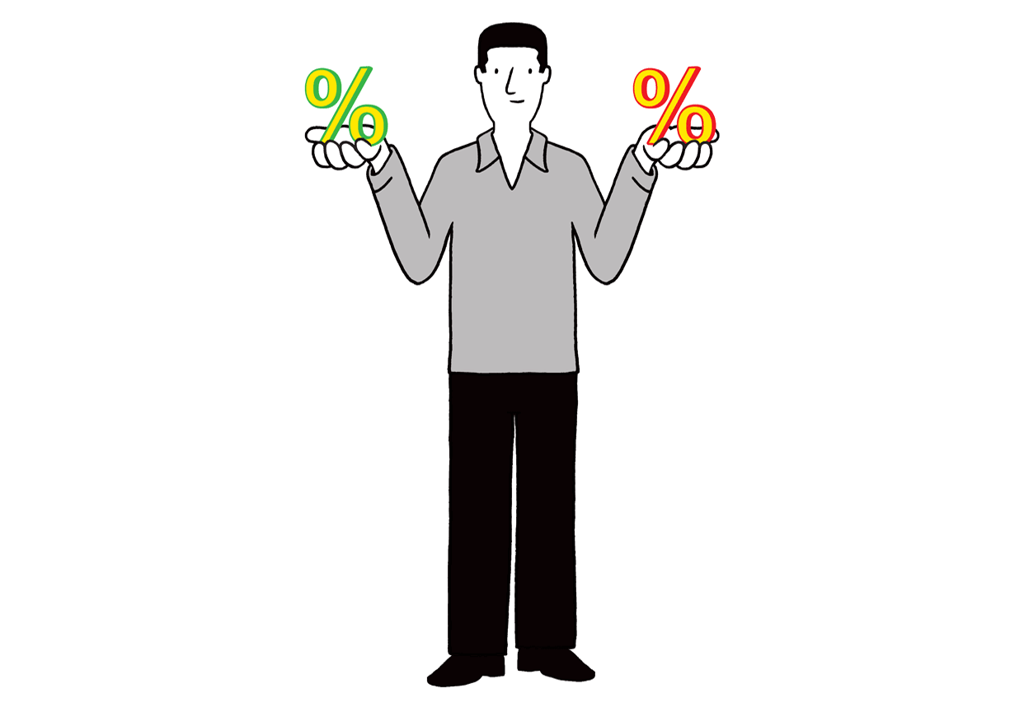
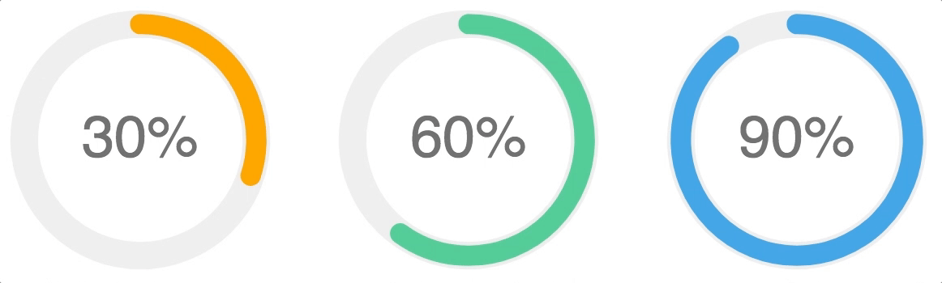

Slide 48

Events

Slide 49
04
Conclusion

Slide 50
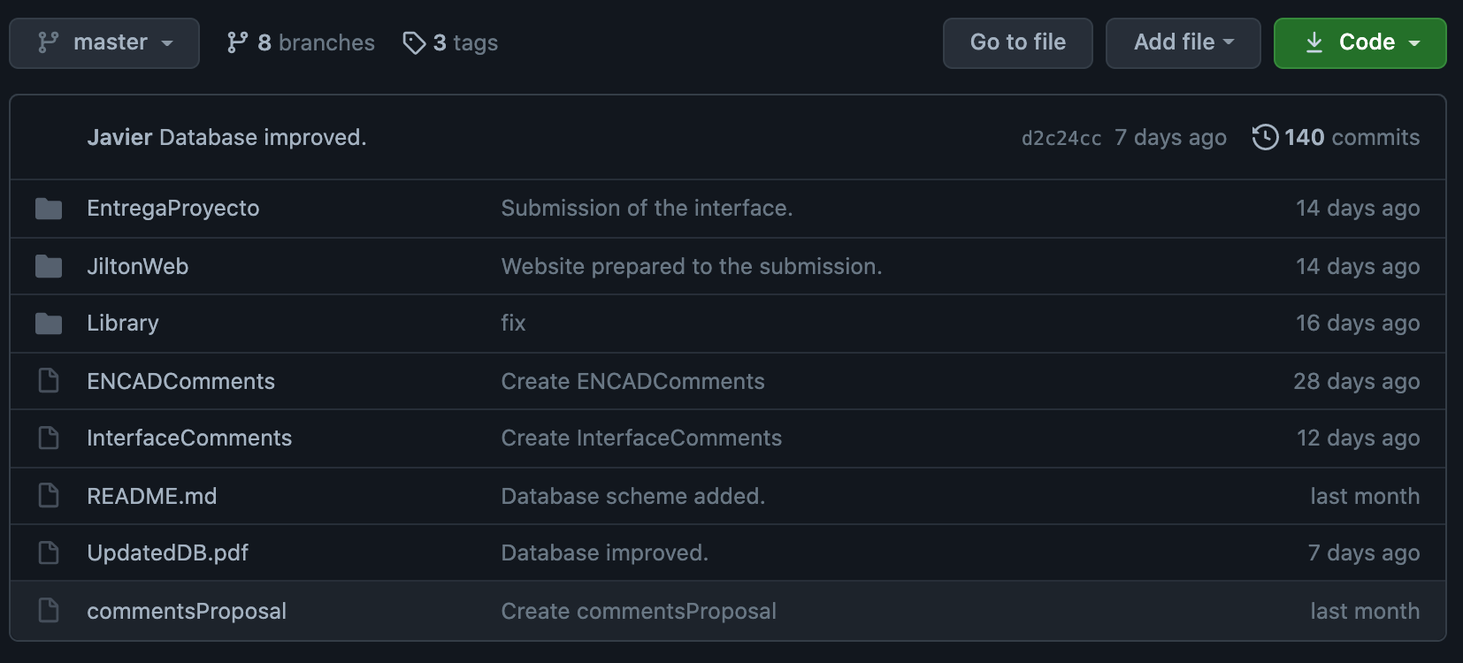
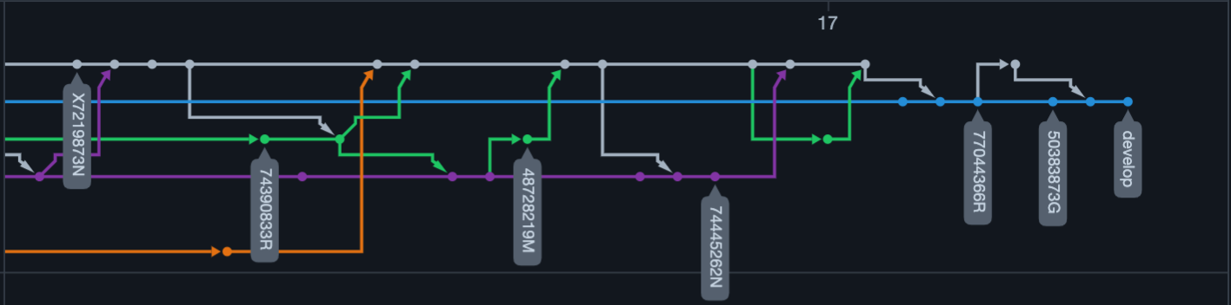
Teamwork and goals

